Slide 1
Deep Dive of the SharePoint Framework
Testing HelloWorld web part in SharePoint

Slide 2
Agenda
Test On Local Machine
Test in Classic Page
Test in Modern Page
Q&A

Slide 3
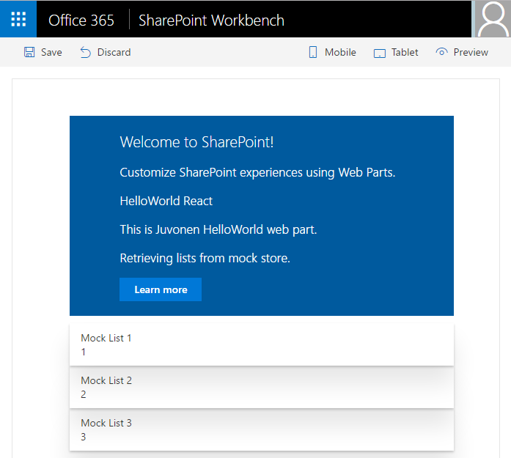
SharePoint Workbench
Local development time experience
Test your changes immediately even in offline mode

Slide 4
Debugging
Build and run on local server and automatically launch local SharePoint Workbench
Build and run solution on local server
> gulp serve
> gulp serve --nobrowser

Slide 5
Local Workbench vs. SharePoint Workbench
Local
Runs on https://localhost
Has no SharePoint Context
Use mock data
SharePoint
Runs on SharePoint Site (https://<your-sharepoint-site>/_layouts/workbench.aspx)
Has SharePoint Context
Use SharePoint data

Slide 6
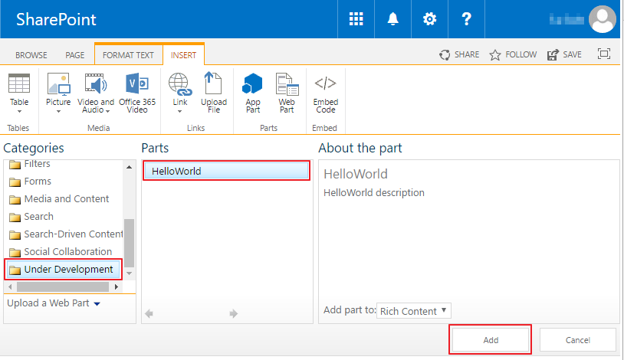
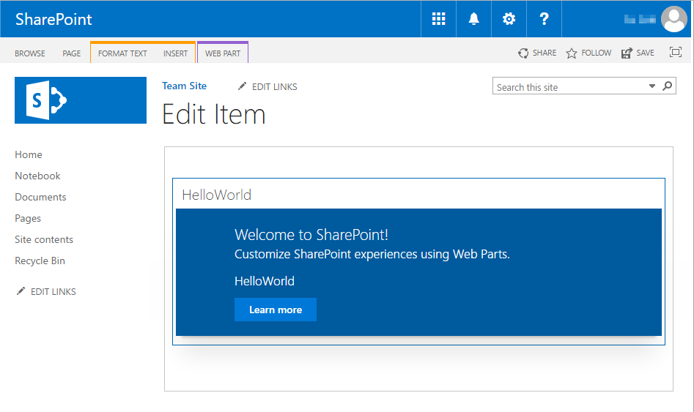
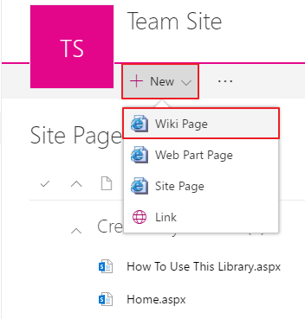
Classic Page

Slide 7
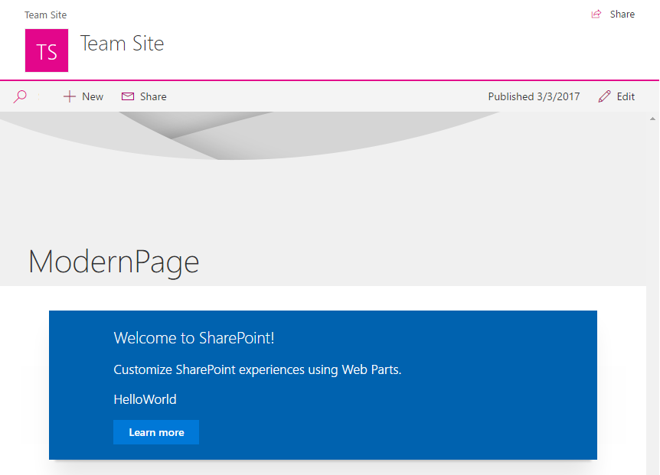
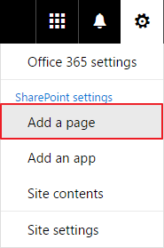
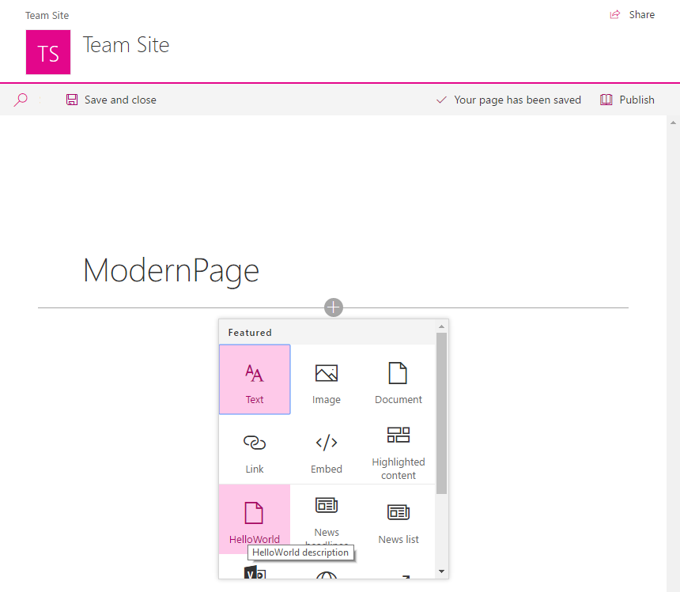
Modern Page

Slide 8
DEMO
Testing the HelloWorld web part in Classic and Modern Pages
Notes:
Use the Testing the HelloWorld web part in SharePoint - Testing in a classic SharePoint page and the Testing in a modern SharePoint page exercises in the lab manual.

Slide 9
Summary
Test On Local Machine
Test in Classic Page
Test in Modern Page
Q&A

Slide 10

Sharing is caring…
Code samples and solutions
Reusable components
Guidance documentation
Monthly community calls
SharePoint Framework
SharePoint add-ins
Microsoft Graph
Office 365 APIs
http://aka.ms/SharePointPnP

Slide 11

Q&A

Slide 12


